Slide 1
Active Filter & Voltage Regulators
UNIT IV

Slide 2
INTRODUCTION
A filter is a device that passes electric signals at certain frequencies or frequency ranges while preventing the passage of others. — Webster.
Analog filters may be classified as either passive or active and are usually implemented with R, L, and C components and operational amplifiers.
Digital filters are implemented using a digital computer or special purpose digital hardware.
Passive
Active

Slide 3
Cont…
. An active filter is one that, along with R, L, and C
components, also contains an energy source, such
as that derived from an operational amplifier.
. A passive filter is one that contains only R, L, and
C components. It is not necessary that all three be
present. L is often omitted (on purpose) from
passive filter design because of the size and cost
of inductors – and they also carry along an R that
must be included in the design.

Slide 4
Passive Filters
made up of passive components - resistors, capacitors and inductors
no amplifying elements (- transistors, op-amps, etc)
no signal gain
1st order - design is simple (just use standard equations to find resonant frequency of the circuit)
2nd order - complex equations
require no power supplies
not restricted by the bandwidth limitations of the op-amps
can be used at very high frequencies
can handle larger current or voltage levels than active devices
buffer amplifiers might be required

Slide 5
Passive elements : Inductor BIG PROBLEM!
high accuracy (1% or 2%), small physical size, or large inductance values are required ??
standard values of inductors are not very closely spaced
difficult to find an off-the-shelf inductor within 10 percent of any arbitrary value
adjustable inductors are used
tuning such inductors to the required values is time-consuming and expensive for larger quantities of filters
inductors are often prohibitively expensive

Slide 6
Active Filter
no inductors
made up of op-amps, resistors and capacitors
provides virtually any arbitrary gain
generally easier to design
high input impedance prevents excessive loading of the driving source
low output impedance prevents the filter from being affected by the load
at high frequencies is limited by the gain-bandwidth of the op-amps
easy to adjust over a wide frequency range without altering the desired response

Slide 7
Categories of Filters
Low Pass Filters:
pass all frequencies from dc up to the upper cutoff frequency.
High Pass Filters:
pass all frequencies that are above its lower cutoff frequency
Low-pass response
High-pass response

Slide 8
Categories of Filters
Band Pass Filters:
pass only the frequencies that fall between its values of the lower and upper cutoff frequencies.
Band Stop (Notch) Filters:
eliminate all signals within the stop band while passing all frequencies outside this band.
Band Pass Response
Band Stop Response

Slide 9
Fundamentals of Low-Pass Filters
Equivalent Filters
Passive Filter
Active Filter
Typical for filters > 1MHz.
For freq < 1MHz, L is physically large.

Slide 10

Low-Pass Filter Design
Transfer Function:
Normalized Frequency:

Slide 11
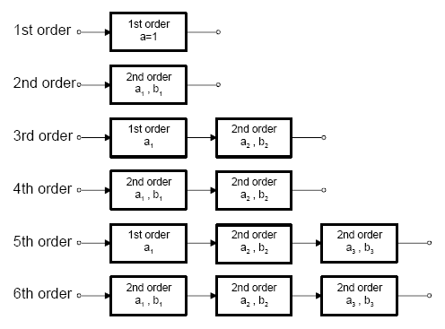
Cascading of Filter Stages to Achieve Higher Order Filters

Slide 12
Cascading of Passive Low-pass Filter Stages

Slide 13
Cascading of Passive Low-pass Filter Stages
(16-1)

Slide 14
Low-Pass Filter Design

Slide 15
Pole
In a filter a pole is nothing more than an RC circuit
n-pole filter → contains n-RC circuit.
Single-Pole Low/High-Pass Filter
Low Pass Filter
High Pass Filter

Slide 16
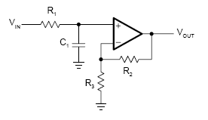


First Order (Single-Pole) Filter Implementation

Slide 17
First Order Filter Implementation

Slide 18
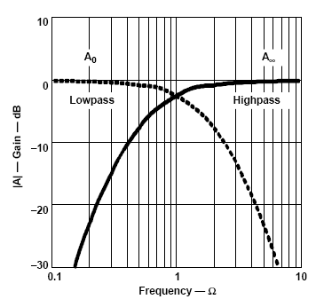
High-Pass Filter Design

Slide 19
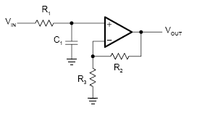
First Order High- and Low-pass Filter Topologies
High-pass
Low-pass
Non inverting
Inverting

Slide 20
First Order High- and Low-pass Filter Topologies
Low-pass
High-pass
Non inverting
Low-pass ➔ High-pass
Exchange Rs with Cs
Ω ➔ 1/Ω
S ➔ 1/S
Note: Ω refers to frequency (f)

Slide 21
First Order High- and Low-pass Filter Topologies
Non inverting
Low-pass
High-pass

Slide 22

First Order High- and Low-pass Filter Topologies
High-pass
Non inverting

Slide 23
Second Order Filter Implementation
There are two Topologies
Sallen and Key Topology for 2nd Order Lowpass Filter
2. Multiple Feedback Topology for 2nd Order Lowpass Filter

Slide 24
Second Order Filter Implementation
Sallen and Key Topology for 2nd Order Lowpass Filter
Sallen and Key Topology for 2nd Order Lowpass Filter
(Unity Gain)

Slide 25


Second Order Filter Implementation
Sallen and Key Topology for 2nd Order Lowpass Filter
Unity Gain

Slide 26
Sallen and Key Topology for 2nd Order Lowpass Filter
Unity Gain

Slide 27
Second Order Filter Implementation
Multiple Feedback Topology for 2nd Order Lowpass Filter

Slide 28
Second Order Filter Implementation
Multiple Feedback Topology for 2nd Order Lowpass Filter
Sallen and Key

Slide 29
Second Order Filter Implementation
Multiple Feedback Topology for 2nd Order Lowpass Filter

Slide 30
Second Order Filter Implementation
Multiple Feedback Topology for 2nd Order Lowpass Filter
where

Slide 31
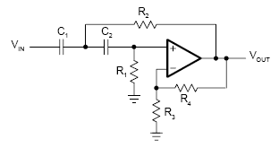
Second Order High- and Low-pass Filter Topologies
High-pass
Low-pass
Sallen and Key
Multiple Feedback

Slide 32
Cascading of Filter Stages to Achieve Higher Order Filters

Slide 33
Three-Pole Low-Pass Filter

Slide 34
Passive RC Low-Pass Filter Responses
Gain
Phase
Roll-off Slope for 1st Order:
20dB/decade <= > 6dB/octave
Phase Shift for 1st Order:
0º @ low freq ➔ -90º @ high freq

Slide 35
Non Ideal Filter Response Characteristics
Uneven gain in the pass band
Gradual transition from Passband to Stopband
Gain
Phase
Nonlinear phase slope leading to distortion
1.5 Octaves
Passband
Stopband

Slide 36

Low-pass to Band-pass Filter Design
S ➔
Note: Ω refers to frequency

Slide 37
Low-pass to Band-pass Filter Design
Note: Ω refers to frequency

Slide 38
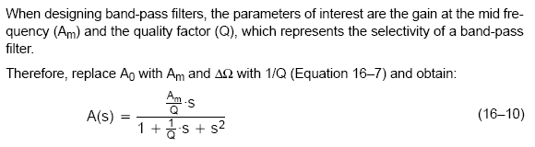
Low-pass to Band-pass Filter Design

Slide 39
Low-pass to Band-pass Filter Design
Wide-band Filters
Narrow-band Filters

Slide 40
Sallen and Key Second Order Topologies
High-pass
Low-pass
Band-pass

Slide 41
Sallen and Key Band-pass Filter
Note: Ω refers to frequency

Slide 42
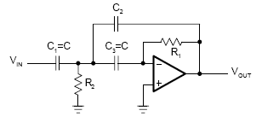
Multiple Feedback Second Order Topologies
High-pass
Low-pass
Band-pass

Slide 43
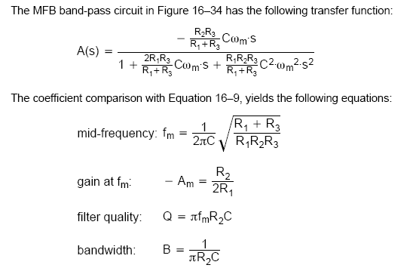
Multiple Feedback Band-pass Filter
384.38
Note: Ω refers to frequency

Slide 44
Two-Stage Band-Pass Filter
BW = f₂ – f₁
Q = f₀ / BW

Slide 45
Band-Stop (Notch) Filter
The notch filter is designed to block all frequencies that fall within its bandwidth. The circuit is made up of a high pass filter, a low-pass filter and a summing amplifier. The summing amplifier will have an output that is equal to the sum of the filter output voltages.
Block diagram
Frequency response

Slide 46
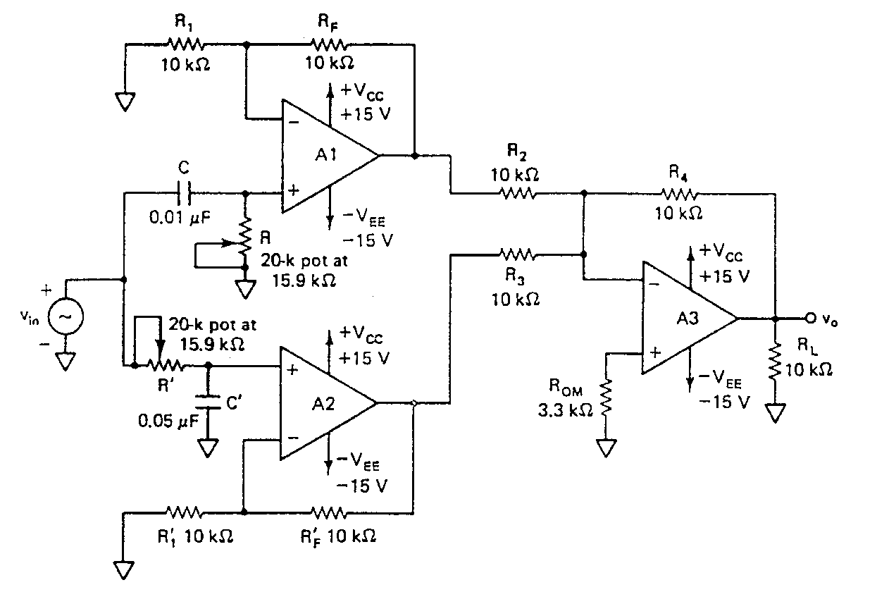
Notch filter

Slide 47
Transfer function H(jω)

Slide 48
Frequency transfer function of filter H(jω)
Note: f₀ is operating(present) frequency
f_{L} is Lower cutoff frequency
f_{H} is Higher cutoff frequency

Slide 49
Optimization of Filter Design

Slide 50

Optimization of Filter Design

Slide 51
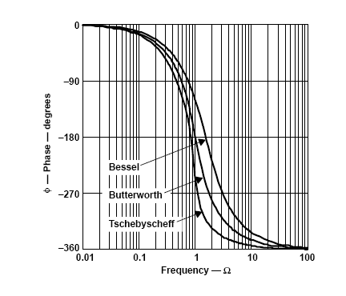
Bessel Characteristic
Optimized for linear phase response up to f_{c}
Flat response in the passband.
Role-off rate less than 20dB/decade/pole.
Phase response is linear.
Used for filtering pulse waveforms without distorting the shape of the waveform.
Note: Ω refers to frequency

Slide 52
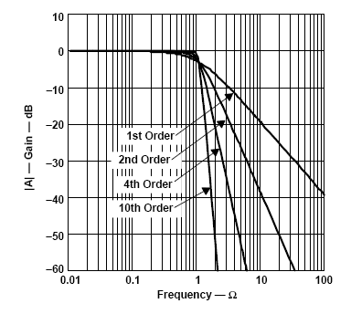
Butterworth Characteristic
Very flat amplitude, A_{v(dB)} , response in the passband.
Role-off rate is 20dB/decade/pole.
Phase response is not linear.
Used when all frequencies in the passband must have the same gain.
Often referred to as a maximally flat response.
Optimized for maximum flatness in the passband
Note: Ω refers to frequency

Slide 53
Chebyshev Characteristic
Overshoot or ripples in the passband.
Role-off rate greater than 20dB/decade/pole.
Phase response is not linear - worse than Butterworth.
Used when a rapid roll-off is required.

Slide 54
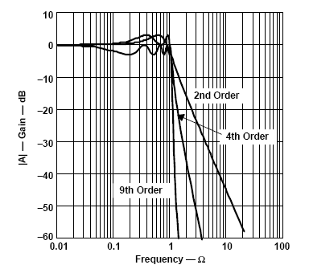
Cont…
Optimized to sharpen the transition from passband to stopband
Ripple in the Passband
Steep Transition Slopes
Note: Ω refers to frequency
Passband Stopband

Slide 55
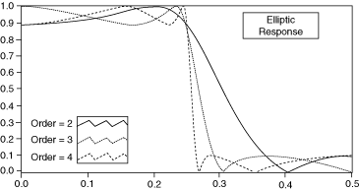
Elliptic (Cauer) Filter
Optimized for steepest transition from passband to stopband for a given filter order.
Has ripple in both passband and stopband, however.
Ripple in Passband
Ripple in Stopband

Slide 56
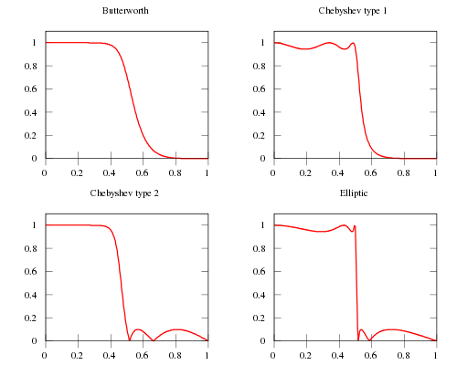
Filters Optimized to Sharpen the Transition from Passband to Stopband
Ripple in Passband
Ripple in Stopband

Slide 57
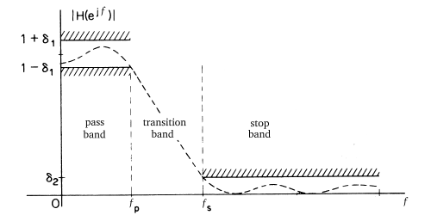
Infinite Impulse Response (IIR)
Filter Design Template – Filter in Software

Slide 58
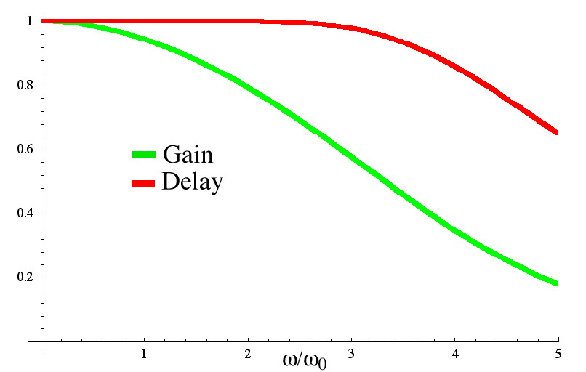
Group Delay
Group delay is a measure of the transit time of a signal versus frequency.
Group delay is a useful measure of phase distortion, and is calculated by differentiating the phase response versus frequency.
Gain and Group Delay of a Bessel Filter
Constant Group Delay and Linear Phase in Transition Region

Slide 59
Group Delay
Group delay is a measure of the slope of the transmission phase response.
The linear portion of the phase response is converted to a constant value (representing the average signal-transit time) and deviations from linear phase are transformed into deviations from constant group delay.
The variations in group delay cause signal distortion, just as deviations from linear phase cause distortion.

Slide 60
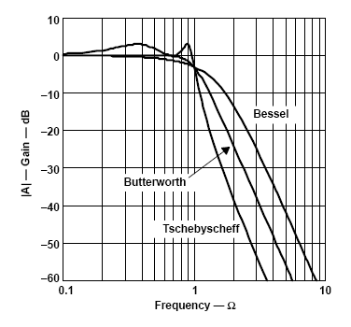
Gain, Phase and Group Delays across Filter Types
Gain Response
Phase Response
Group delay
Note: Ω refers to frequency

Slide 61
Quality or “Q” Factor
f₀
Q =
f_{H} - f_{L}
Note: Ω refers to frequency

Slide 62
Voltage Regulators
Used to provide a stable dc voltage for powering other electronic circuits
Voltage regulators are classified as
Series Regulator
Shunt Regulator
Switching regulator

Slide 63
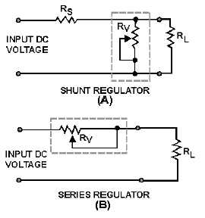
Shunt Regulator
The regulating device is connected in parallel with the load resistance
Series Regulator
The regulating device is connected in parallel with the load

Slide 64
Switching Regulator
Switching regulator uses a power transistor as a switch that are in one of two states, on or off.
The advantage is that the switch dissipates very little power in either of these two states and power conversion can be accomplished with minimal power loss, which equates to high efficiency.

Slide 65
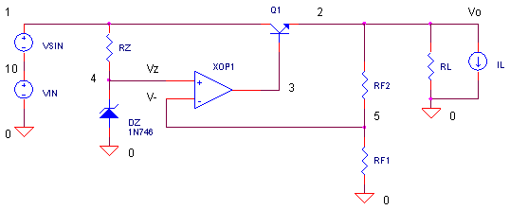

OPAMP REGULATOR WITH SERIES-PASS TRANSISTOR

Slide 66
Three basic components needed to achieve good voltage regulation are
A precision reference (zener diode) to set the output voltage.
A muscle component (transistor) to deliver the required current.
An automatic controller (opamp) to adjust the transistor drive. The “prime directive” of the opamp is to adjust the base drive of Q1 delivering the required load current while keeping the output voltage at a fixed value.

Slide 67
THREE TERMINAL VOLTAGE REGULATORS
FIXED VOLTAGE REGULATORS:
positive fixed voltage regulators -78XX series (+5v, +6v, +8v, +12v, +15v, +18v and +24v)
fixed negative voltage regulators - 79XX series (Two extra voltage options of -2V and -5.2V)
Available in two packages
- Metal package (TO-3 type)
- Plastic package (TO-220 type)
ADJUSTABLE VOLTAGE REGULATOR

Slide 68
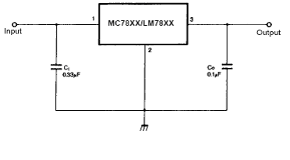
FIXED VOLTAGE REGULATOR
Capacitor Ci is used to cancel the inductive effects due to long distribution cables.
Capacitor Co improves the transient response

Slide 69
Load Regulation
It is defined as the percentage change in the output voltage for a change in load current and is usually expressed in mv or as a % of the output voltage. Typical value of line regulation for 7805 is 15mV.
Line Regulation:
It is defined as the percentage change in the output voltage for a change in the input voltage and is usually expressed in mv or as a % of the output voltage. Typical value of line regulation for 7805 is 3mV.
Ripple Rejection
The IC regulator not only keeps the output voltage constant but also reduces the amount of ripple voltage. It is expressed in dB. Typical value for 7805 is 78 dB.

Slide 70
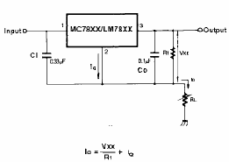
Constant Current Source

Slide 71
Adjustable Output Regulator
Vo = VR1 + V R2
= VR1+ (IQ + I R1) R2
= VR1+IQR2+ VR1/R1*R2
= (1+R2/R1) VR1 + IQR2

Slide 73
723 GENERAL PURPOSE REGULATOR
Problems with series op amp voltage regulators
– The zener diode reference voltage will vary with temperature.
– The zener diode current should be supplied by a current source,
- instead of a resistor, to give much better ripple rejection.
– We are powering the op-amp with two perfect 15-volt voltage sources, which is very impractical, given that we’re trying to make a voltage source!
– The circuit is not protected against overload. If the load resistor is
too small, the output transistor could overheat.
• Problems with three terminal voltage regulators
- No short circuit protection
- Output voltage (positive or negative) is fixed

Slide 74
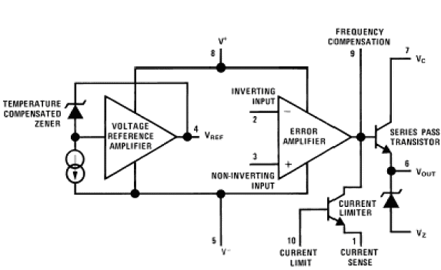

Slide 75
The zener diode, a constant current source and reference amplifier produce a fixed voltage of about 7v at the terminal Vref. The constant current source forces the zener to operate at a fixed point so that the zener outputs a fixed voltage.
The other section consists of an error amplifier, a series pass transistor and a current limit transistor. The error amp compares the output voltage applied at the INV input to the REF voltage at the NI input. The error voltage controls the conduction of series pass transistor.

Slide 76
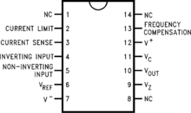
IC 723 PIN DIAGRAM

Slide 77
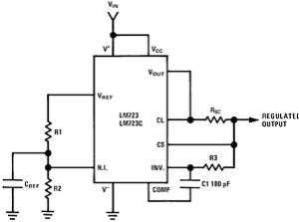
Low Voltage Regulator
The voltage at NI terminal due to R1R2 divider is
VNI =(Vref . R2)/(R1+R2)
Since the pass transistor act as a emitter follower
VO =(Vref . R2)/ (R1+R2)
The Reference voltage is typically 7.15V ,So the output voltage VO is
VO = (7.15 . R2) / (R1+R2)
Which is always less than 7.15V

Slide 79
In current limiting technique, the load current is maintained at a preset value and when overload occurs, Vo drops to zero. If the load is short circuited, maximum current flows through the regulator. To limit the short circuit current and to allow higher current to the load foldback technique is used.

